Slide 1

LGBTQ Youth
-Diversity & Inclusion-
May 6th and 7th, 2021

Slide 2


Who am I?
Jackie Gunderson-
  Pronouns: She/Her
  Lead Facilitator of Friends Like Us (youth group) through the CIPHC
    “A safe space to be yourself, whoever that might be.”
    For youth 13-19 years old
  Married (for 5 years) to an amazing partner (and chef) who happens to be non-binary (uses they/them pronouns)
  Roller Derby Athlete
  Director of the Penguin Project of McLean County
  Full-time ISU employee and full-time student
  Dedicated to my community
  Openly queer, outspoken advocate
  Recently transitioned back into civilian life after running for office

Slide 3
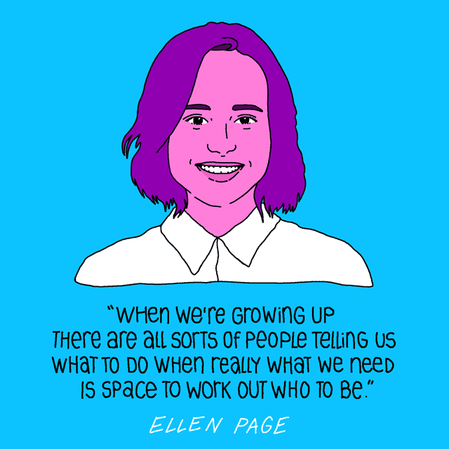
Why aM I here?
To promote the health and well-being of the LGBTQIA youth of Central Illinois without judgement or discrimination based on race, color, ethnicity, age, gender, gender identity, sexual orientation, or disability.
To raise awareness to recognize and transcend inherent biases, address unconscious prejudice, and see cultural competency as an ongoing process of development.
To give you the opportunity to learn more about how to live authentically through life’s challenges and opportunities.
To be a resource and advocate.
Elliot

Slide 4

What I need from you!
Interaction!
  I want to connect with you!
  Lean in, we’re here to get it right →
  Unfamiliar = Uncomfortable = Okay
Be yourself!
  Fully!
  Authentically!
  I respect all identities, pronouns and names.
    (I ask you to do the same)
Specific Questions, Comments and Concerns you have.

Slide 5
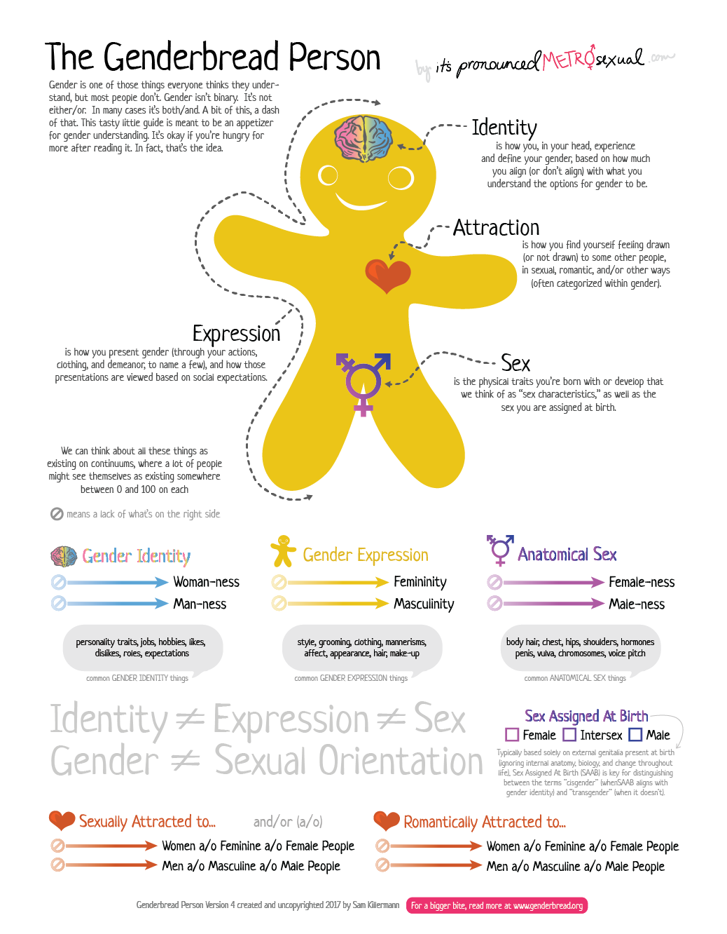
genderbread.org

Slide 6
Gender, Sexuality, and personal identity are complicated. It doesn’t have to make sense to you, in order to respect that it makes sense to them.

Slide 7
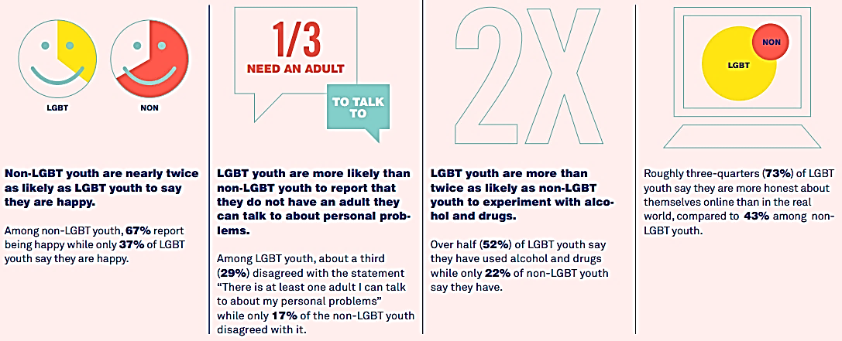
our community
In the US, an estimated 3.2 million youth (ages 8-18) are LGBTQ. Among older youth, approximately 8% or 1.6 million youth (in grades 9-12) identify as LGB, and nearly 1% or 150,000 youth (ages 13-17) identify as transgender.
Only 48% of 13-20 year olds identified as “completely heterosexual” in a recent study

Slide 8
Did you know?
85% of LGBT students have experienced verbal harassment
58% of LGBT youth have felt unsafe at school due to their sexual orientation; 43% have felt unsafe because of their gender identity
27% of LGBT students have been physically harassed at school because of their sexual orientation; 13% have been physically harassed because of their gender identity
In 2015, the Centers for Disease Control and Prevention found that with regard to LGB youth:
  34% have experienced bullying while on school grounds
  28% have experienced electronic or cyber bullying
The 2015 U.S. Transgender Survey found that of those who identified as transgender in K-12 grade
  54% reported being verbally harassed
  24% reported being physically attacked
  17% reported leaving a school because mistreatment was so bad
LGBTQ youth are over-represented in the foster care system. This means that the percentage of youth in foster care who are LGBTQ is larger than the percentage of LGBTQ youth in the general youth population.

Slide 9
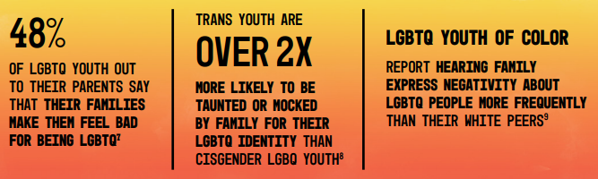
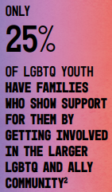
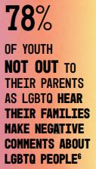
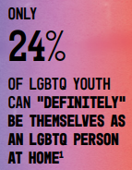
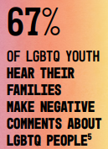
Did you know?

Slide 10
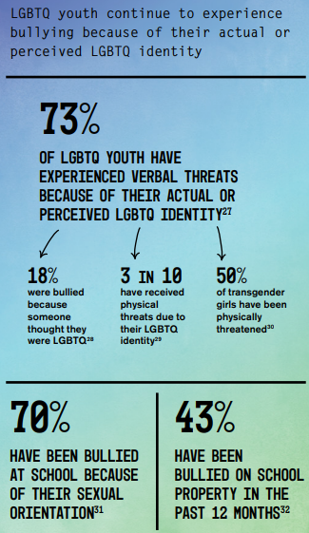
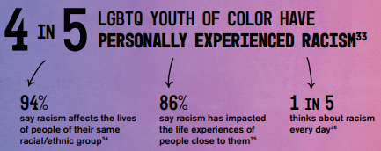
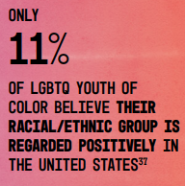
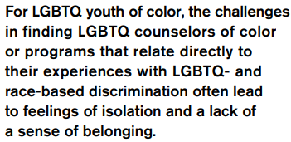
Did you know?

Slide 11
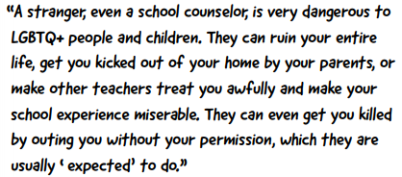
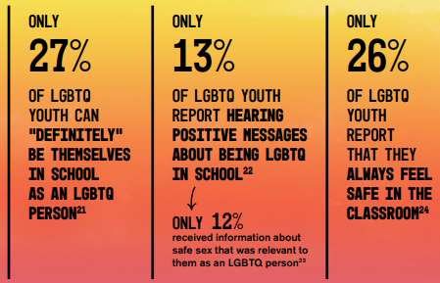
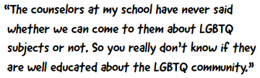
Did you know?
77% of LGBTQ youth surveyed report that on average they had felt down or depressed in the past week.
  Alarmingly, only 41% had received psychological or emotional counseling to address these issues in the past 12 months.
LGBTQ youth of color face even greater challenges in accessing counseling services, with large disparities and an average of 37% of respondents having received psychological or emotional counseling in the past 12 months.
  Importantly, youth who had received counseling reported better mental health outcomes.

Slide 12
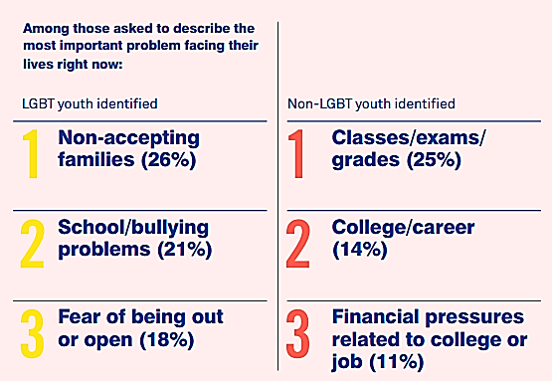
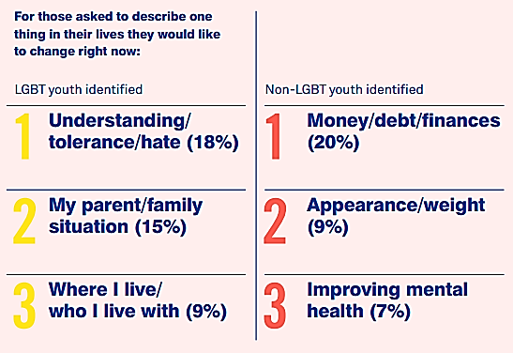
Did you know?

Slide 13

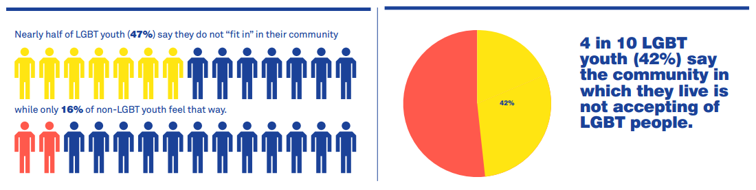
Did you know?
LGBTQ youth of color and transgender teenagers experience unique challenges and elevated stress -- only 11% of youth of color surveyed believe their racial or ethnic group is regarded positively in the U.S., and over 50% of trans and gender expansive youth said they can never use school restrooms that align with their gender identity.

Slide 14

your community
Good news! Supportive environments at home and school help LGBTQ youth thrive.
Strong family bonds, safe schools and support from caring adults can all protect LGBTQ youth from depression and suicidality
In a study published in the Journal of Child and Psychiatric Nursing, Dr. Caitlin Ryan and colleagues found that LGBTQ youth with affirming families reported higher levels of self-esteem and overall health. Youth with the least accepting families were more than 3x as likely to consider and attempt suicide compared to those with highly accepting families.
For transgender youth, family and community support makes all the difference.
Although research has repeatedly found that transgender children experience mental health problems, including suicidality, at high rates, a recent study found that transgender children whose communities affirmed their gender identity were as psychologically healthy as their non-transgender peers.

Slide 15

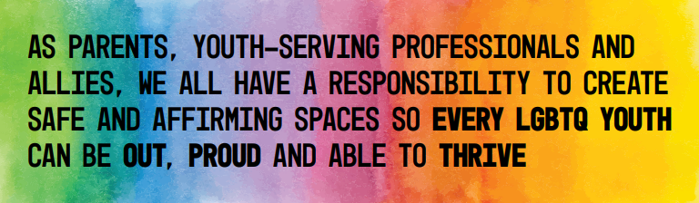
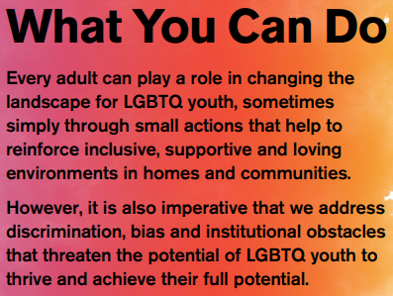
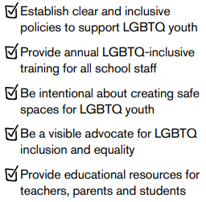

Slide 16
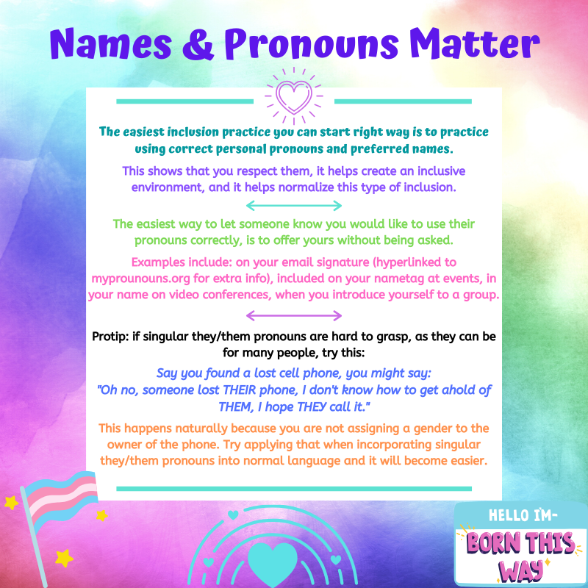

Slide 17


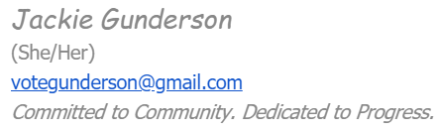
Break the Stigma
For example: I am a cisgender woman (assigned female at birth, identify as female) and I have my pronouns attached to my email signature (hyperlinked to mypronouns.org for extra info)
If you mess up, which we all do, normalize fixing it without a lot of commotion.
If someone corrects you, normalize expressing gratitude instead of regret.
  “Thank you for correcting me” rather than “I’m sorry”

Slide 18
Break the Stigma
A 2014 study found that LGBQ people who live in communities with more stigmatizing attitudes about their sexual orientation die an average of 12 years earlier than LGBQ people in the least-prejudiced communities.
Numerous studies have shown that transgender people who experience more stigma and discrimination are more likely to experience mental health problems or suicidality.
You as an individual have the opportunity to be a part of breaking the stigma.
You have the opportunity to build bridges and establish positive relationships with your youth.
You, as an organization, have an incredible opportunity to lead our community in realizing the benefits of inclusivity.
When you model the way, others notice. What are some ways you have thought of in the last few minutes that you could make this space more inclusive?

Slide 19
Break the Stigma
When you model the way, others notice. What are some ways you have thought of in the last few minutes that you could make this space more inclusive?
Implement non-gendered language wherever possible.
  “Ladies and Gentlemen/Boys and Girls”
  “Friends, Folks, Everyone, Y’all, Students, People, Persons”
  Does a form really need to have gender on it?
    If it does, how can we make sure other options are acceptable?
When you hear things like “In my day, we didn’t have XYZ” whether it is in relation to disabilities, gender, sexuality, or any other identity you can be a part of stopping that kind of language by saying:
“I think what you mean is people used to suffer through quietly because they had zero support or understanding.”

Slide 20
Break the Stigma
When you hear things like “In my day, we didn’t have XYZ” whether it is in relation to disabilities, gender, sexuality, or any other identity you can be a part of stopping that kind of language by saying:
“I think what you mean is people used to suffer through quietly because they had zero support or understanding.”
We have an opportunity to build a world where these young people see themselves represented in their education, their community, and in leadership, therefore they have the opportunity to live authentically with the proper supports in place.
Representation Matters!
  When I live loudly, proudly, and authentically, I give others permission and space to be their most authentic selves.
  What books are you reading, what stories are you sharing, what other inclusive practices are you including in their education journey?

Slide 21
Resources
Find us on Facebook! (Central Illinois PRIDE Health Center)
  Share our group with youth you know (Age 13-19)
Illinois Safe Schools Alliance www.ilsafeschools.org/
Prairie Pride Coalition - https://ppc-il.org/main/
PFLAG BloNo - www.pflagbn.com/
TransPARENT Central Illinois – support group
Human Rights Campaign – Schools in Transition: A Guide for Supporting Transgender Students in K-12 Schools
The Trevor Project - thetrevorproject.org/

Slide 22



Let’s Connect!
Jackie Gunderson – she/her
jacilyn11@gmail.com

